Slide 1

ANÁLISIS DE DATOS ESPACIALES
EDIER V. ARISTIZÁBAL G.
Ing. Geólogo (Universidad Nacional de Colombia)
Esp. en Gestión de Riesgos Geológicos (Universidad de Ginebra – Suiza)
MSc. en Geociencias (Universidad de Shimane – Japón)
PhD. en Ingeniería (Universidad Nacional de Colombia)
Universidad Nacional de Colombia
Facultad de Minas
Departamento de Geociencias

Slide 2
All models are wrong, but some are useful.
George Box

Slide 3


DECISION TREE

Slide 4
DECISION TREE
A decision tree is a tree-like structure where internal nodes represent a test on an attribute, each branch represents outcome of a test, and each leaf node represents class label, and the decision is made after computing all attributes. A path from root to leaf represents classification rules. Thus, a decision tree consists of three types of nodes.
• Root node
• Branch node
• Leaf node (class label)

Slide 5
DECISION TREE
They are relatively fast to construct and they produce interpretable models (if the trees are small).
They naturally incorporate mixtures of numeric and categorical predictor variables and missing values.
They are invariant under (strictly monotone) transformations of the individual predictors. As a result, scaling and/or more general transformations are not an issue, and they are immune to the effects of predictor outliers.
They perform internal feature selection as an integral part of the procedure.
They are thereby resistant, if not completely immune, to the inclusion of many irrelevant predictor variables.
There is no need for the exclusive creation of dummy variables.
Test attributes at each node are selected on the basis of a heuristic or statistical impurity measure example, Gini, or Information Gain (Entropy).

Slide 6
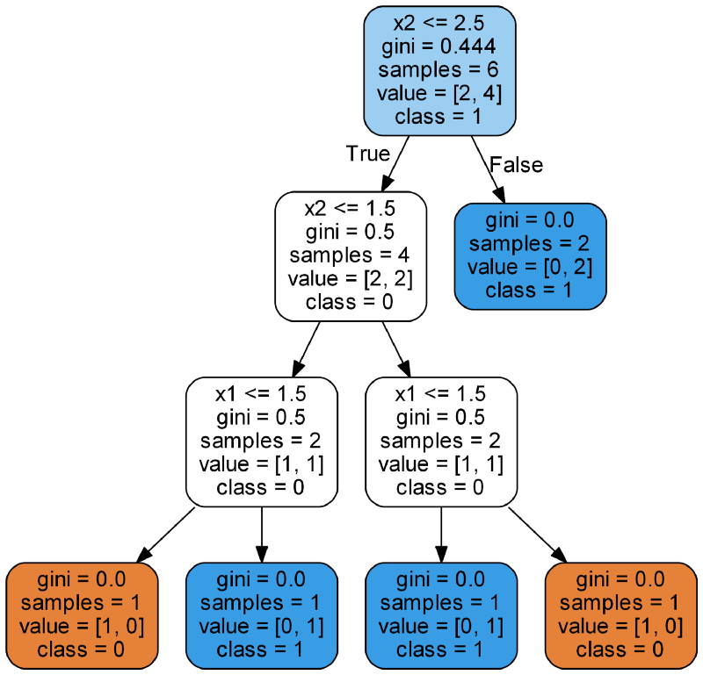
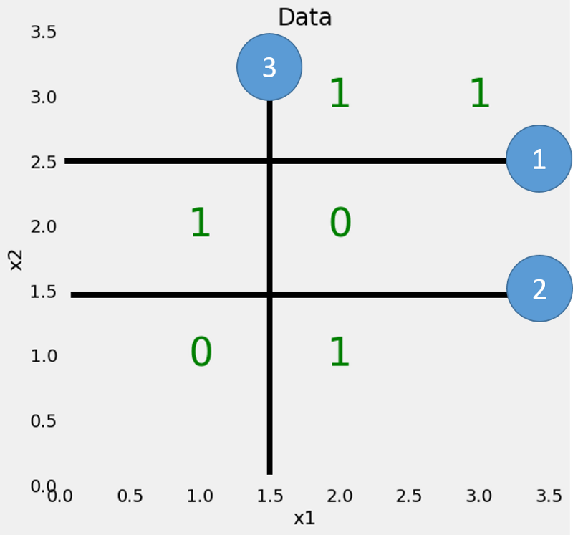
DECISION TREE
Árbol de decisión

Slide 7
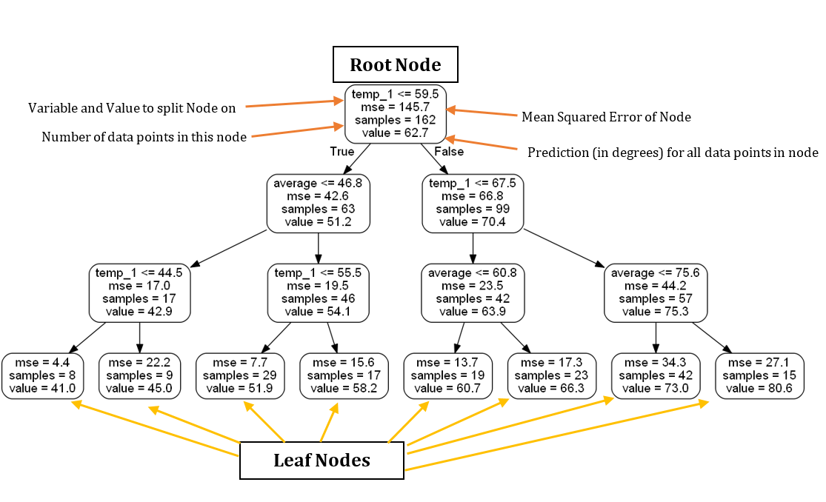
DECISION TREE - regresión

Slide 8
DECISION TREE - clasificación

Slide 9
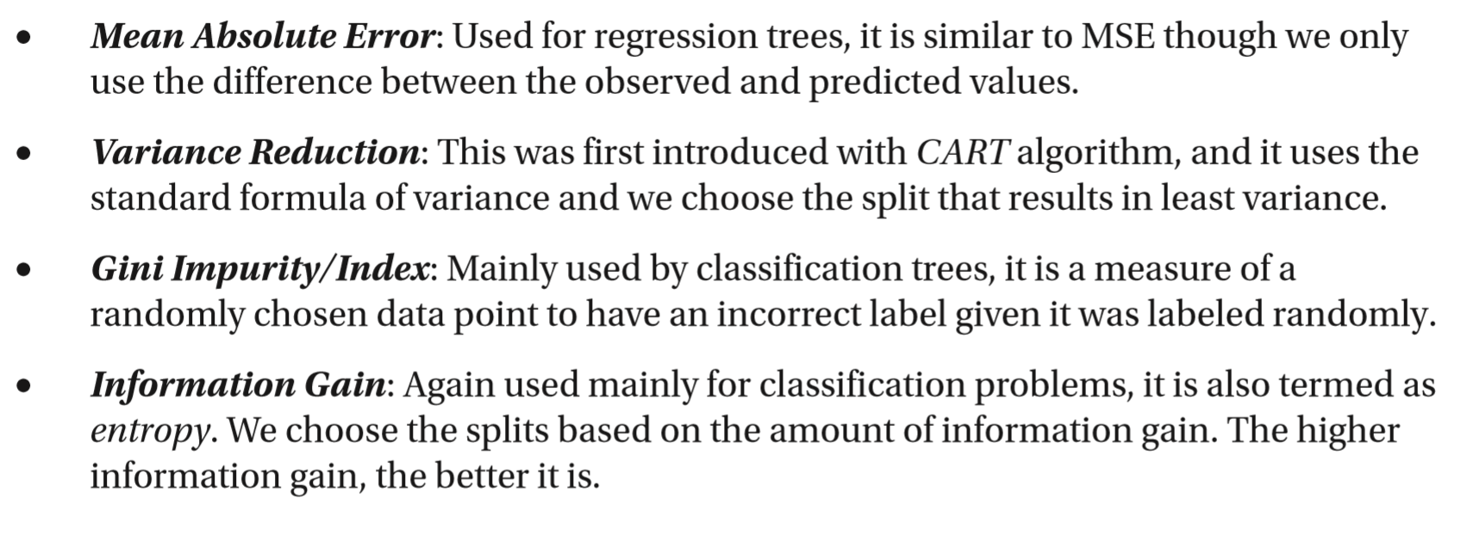
CRITERIOS

Slide 10
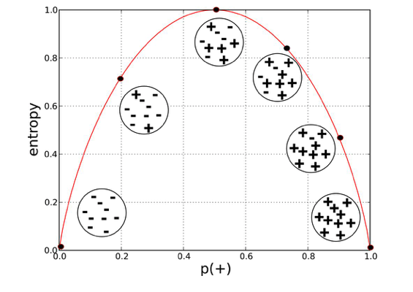
ENTROPY
Max → log₂ C
C: # clases

Slide 11
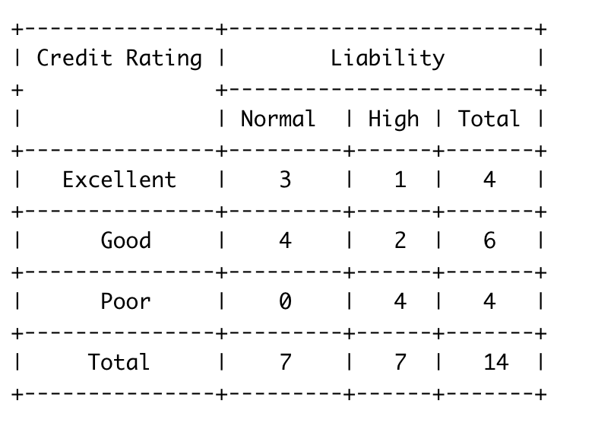
ENTROPY

Slide 12
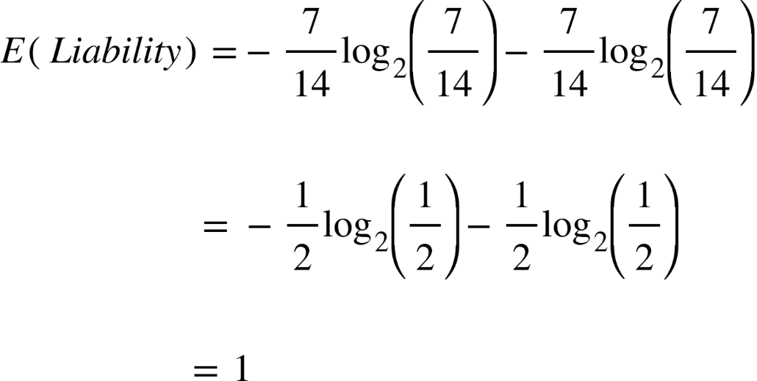
ENTROPY
Probabilidad del Si
Probabilidad del No

Slide 13
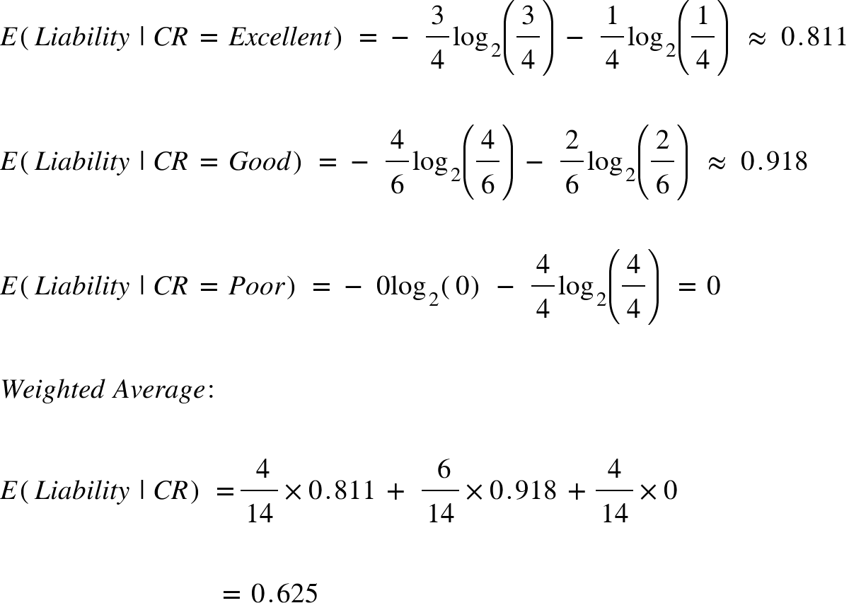
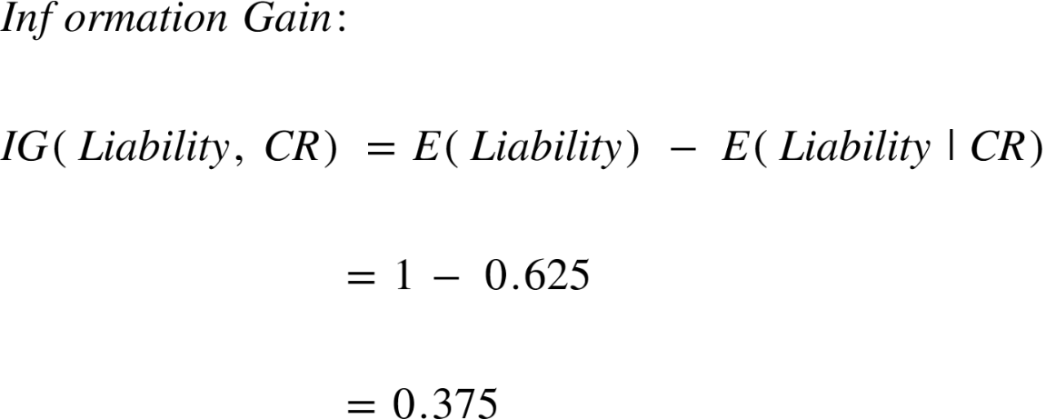
ENTROPY

Slide 14
GINI & ENTROPY
Information Gain
Information gain is another metric which tells us how much a question unmixes the labels at a node. Mathematically it is just a difference between impurity values before splitting the data at a node and the weighted average of the impurity after the split.

Slide 15
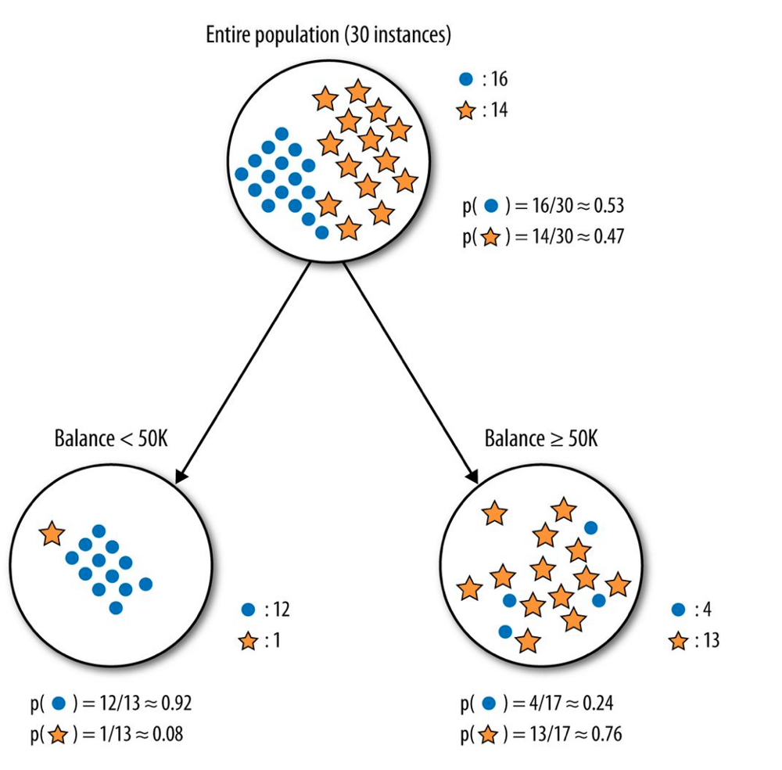
ENTROPY

Slide 16
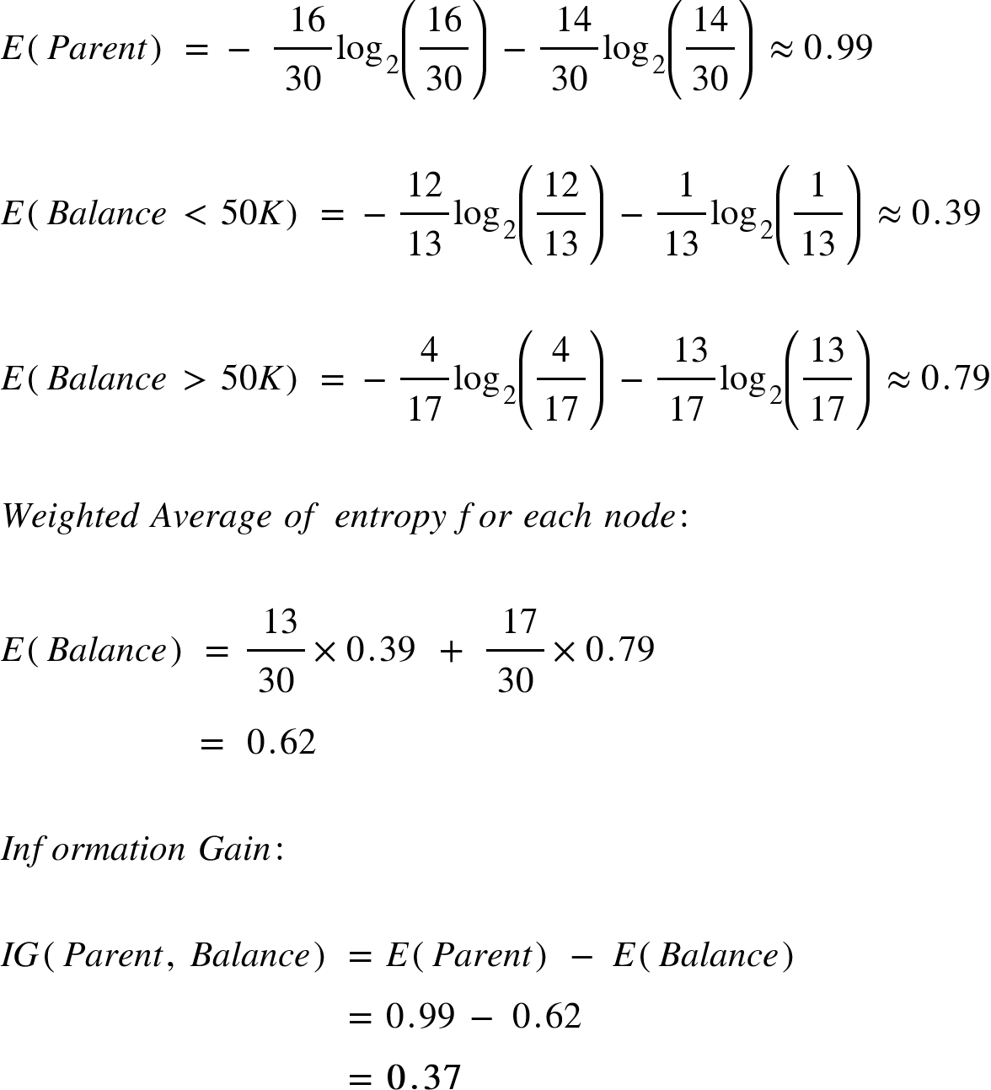
ENTROPY

Slide 17
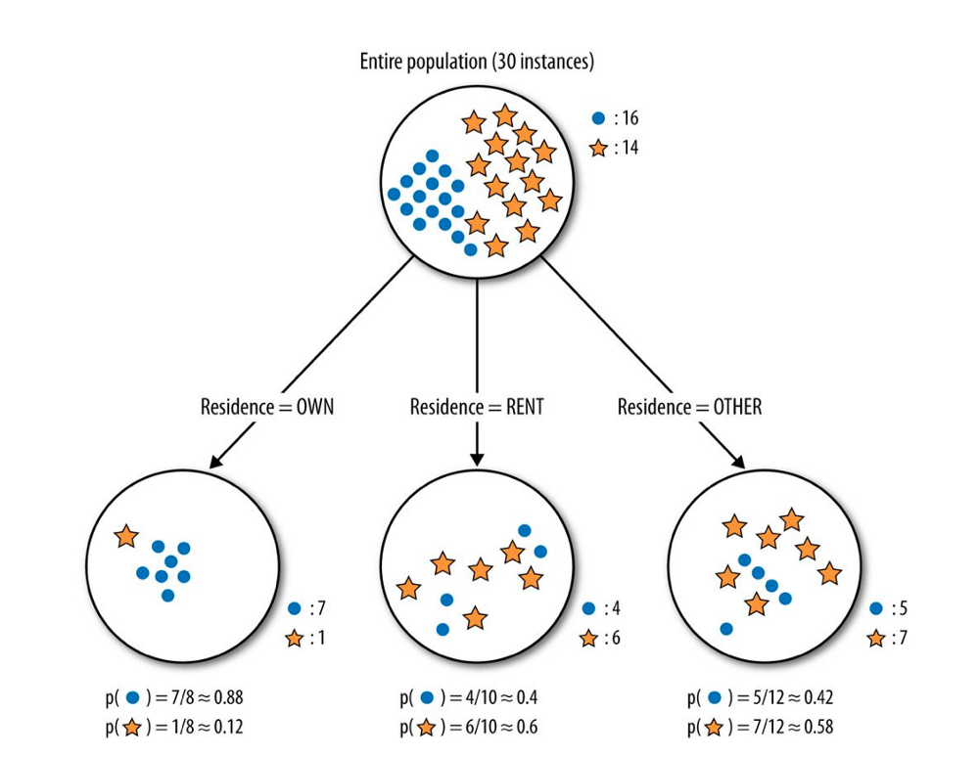
ENTROPY

Slide 18
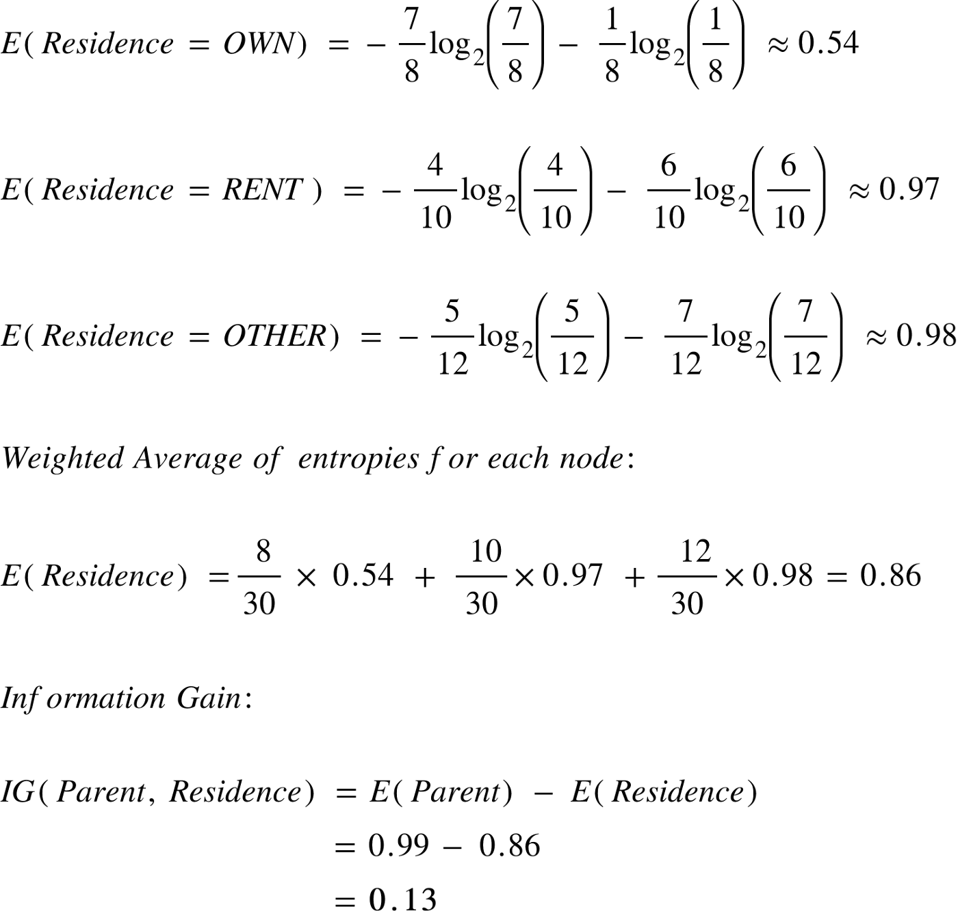
ENTROPY

Slide 19
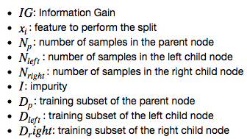
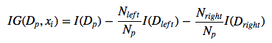
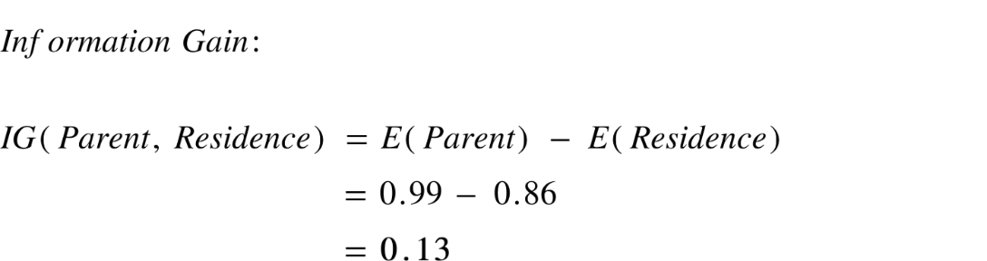
INFORMATION GAIN
The information gain from feature Balance is almost 3 times more than the information gain from Residence!
If you go back and take a look at the graphs you can see that the child nodes from splitting on Balance do seem purer than those of Residence.
Vs

Slide 20
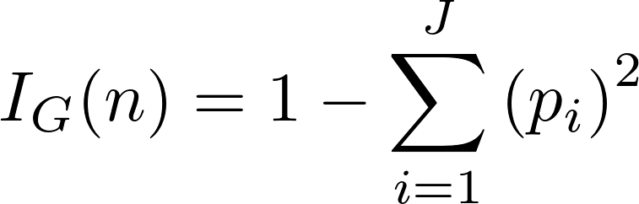
GINI IMPURITY
CART (Classification And Regression Trees).
Es la probabilidad de que una muestra aleatoriamente tomada en un nodo sea incorrectamente clasificada.
I_{G}
It works with categorical target variable “Success” or “Failure”.
It performs only Binary splits
Higher the value of Gini higher the homogeneity.

Slide 21
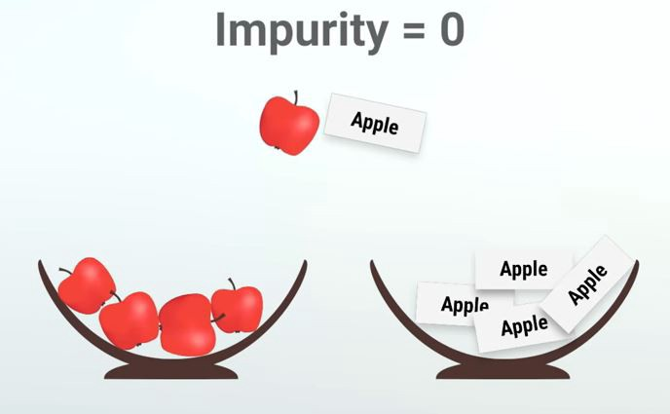
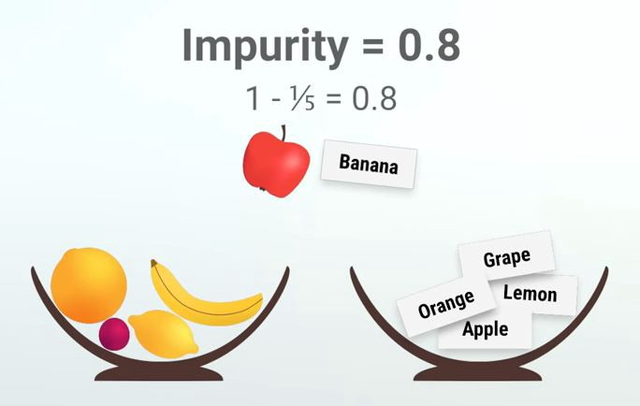
GINI IMPURITY
Gini Impurity
Gini impurity is a metric of measuring the mix of a set. The value of Gini Impurity lies between 0 and 1 and it quantifies the uncertainty at a node in a tree. So Gini Impurity tells us how mixed up or impure a set is. Now our goal with classification is to split or partition our data into as pure or unmixed sets as possible. If we reach at a 0 Gini Impurity value we stop dividing the tree further.

Slide 22
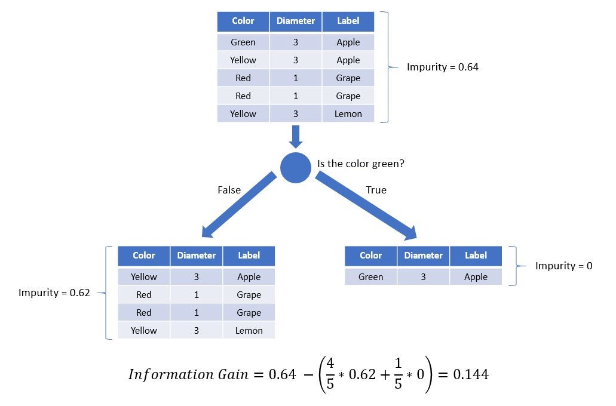
GINI

Slide 23
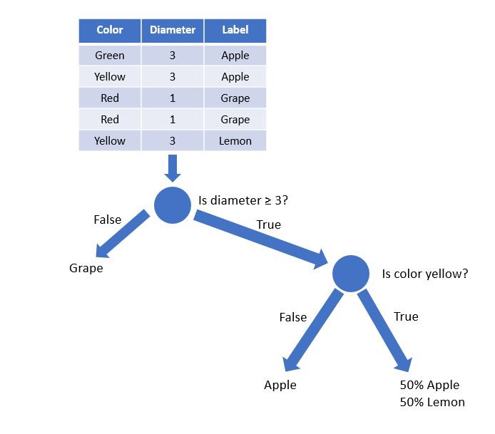
GINI
Also note that the rightmost leaf which says 50% Apple & 50% lemon means that this class cannot be divided further and this branch can tell an apple or a lemon with 50% probability. For the grape and apple branches we stop asking further questions since the Gini Impurity is 0 for those.

Slide 24
EJEMPLO

Slide 25
EJEMPLO

Slide 26
EJEMPLO

Slide 27
EJEMPLO

Slide 28
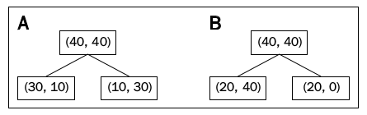
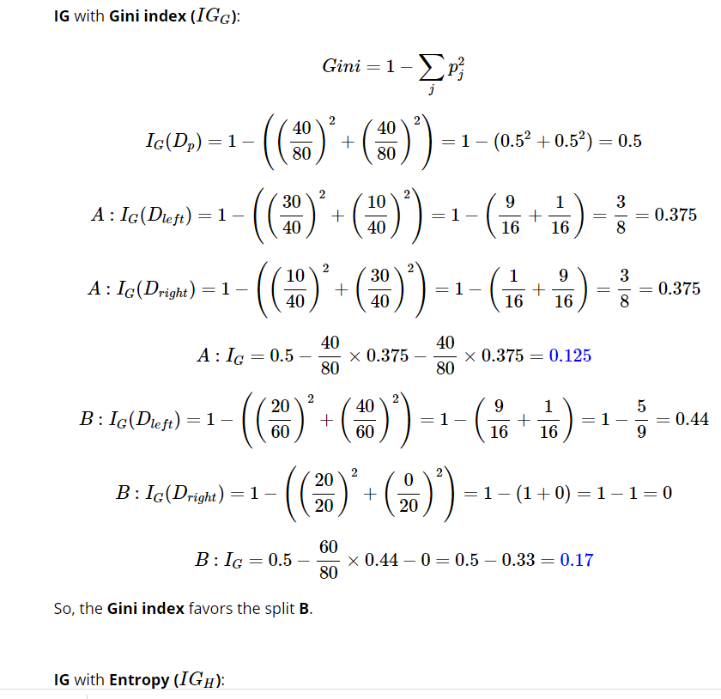
EJEMPLO

Slide 29
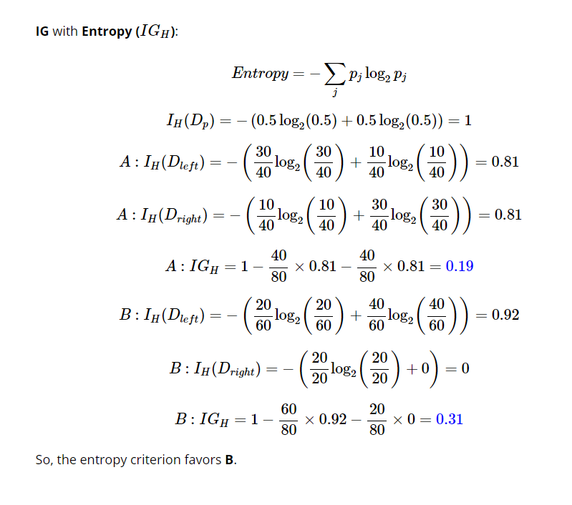
EJEMPLO

Slide 30
ENSEMBLE LEARNING
We all do that. Before we make any big decisions, we ask people’s opinions, like our friends, our family members, even our dogs/cats, to prevent us from being biased or irrational 😍.
The model does that too. it is very common that the individual model suffers from bias or variances and that’s why we need the ensemble learning.
Ensemble learning, in general, is a model that makes predictions based on a number of different models. By combining individual models, the ensemble model tends to be more flexible (less bias) and less data-sensitive (less variance).
Bagging: Training a bunch of individual models in a parallel way. Each model is trained by a random subset of the data.
Boosting: Training a bunch of individual models in a sequential way. Each individual model learns from mistakes made by the previous model.

Slide 31
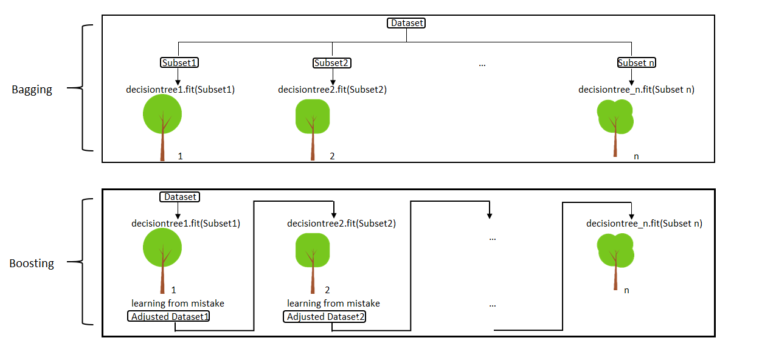
BAGGING vs BOOSTING

Slide 32
ENSEMBLE METHODS
The goal of ensemble methods is to combine the predictions of several base estimators built with a given learning algorithm in order to improve generalizability / robustness over a single estimator.
Two families of ensemble methods are usually distinguished:
In averaging methods, the driving principle is to build several estimators independently and then to average their predictions. On average, the combined estimator is usually better than any of the single base estimator because its variance is reduced. Examples: Bagging methods, Forests of randomized trees, …
By contrast, in boosting methods, base estimators are built sequentially and one tries to reduce the bias of the combined estimator. The motivation is to combine several weak models to produce a powerful ensemble.

Slide 33
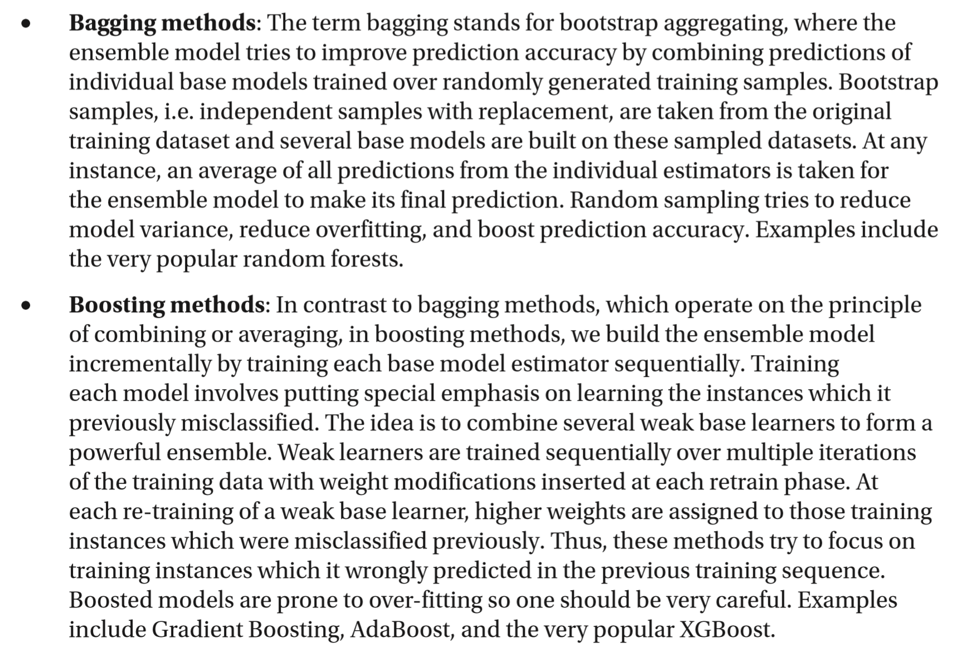
ENSEMBLE METHODS

Slide 34
BAGGING vs BOOSTING
Both are ensemble methods to get N learners from 1 learner.
Both generate several training data sets by random sampling.
Both make the final decision by averaging the N learners (or taking the majority of them i.e Majority Voting).
Both are good at reducing variance and provide higher stability.

Slide 35
BAGGING vs BOOSTING
BAGGING | BOOSTING
Simplest way of combining predictions that belong to the same type. | A way of combining predictions that belong to the different types.
Aim to decrease variance, not bias. | Aim to decrease bias, not variance.
Each model receives equal weight. | Models are weighted according to their performance.
Each model is built independently. | New models are influenced by performance of previously built models.
Different training data subsets are randomly drawn with replacement from the entire training dataset. | Every new subsets contains the elements that were misclassified by previous models.
Bagging tries to solve over-fitting problem. | Boosting tries to reduce bias.
If the classifier is unstable (high variance), then apply bagging. | If the classifier is stable and simple (high bias) the apply boosting.
Random forest. | Gradient boosting.

Slide 36
BAGGING
base models that are often considered for bagging are models with high variance but low bias

Slide 37
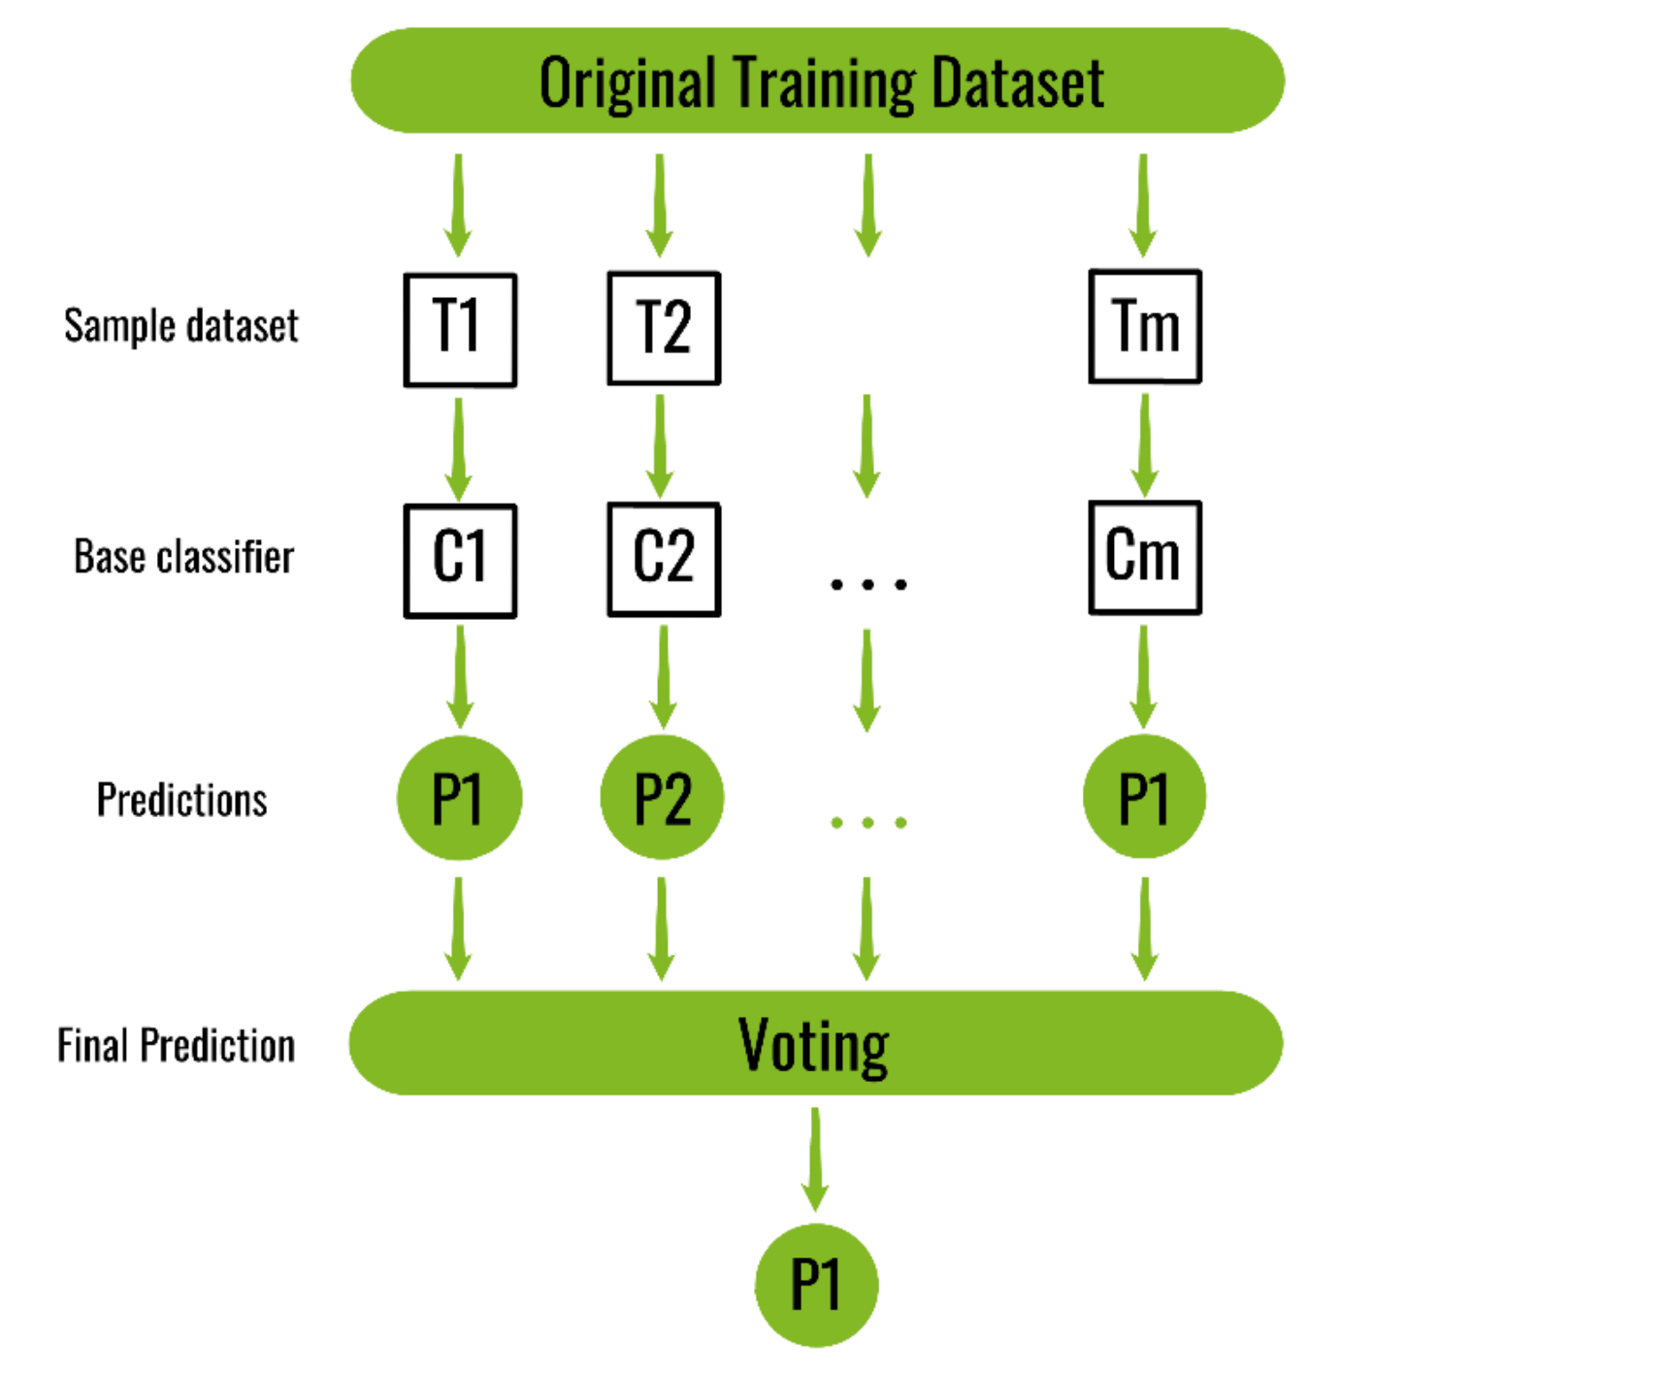
BAGGING

Slide 38
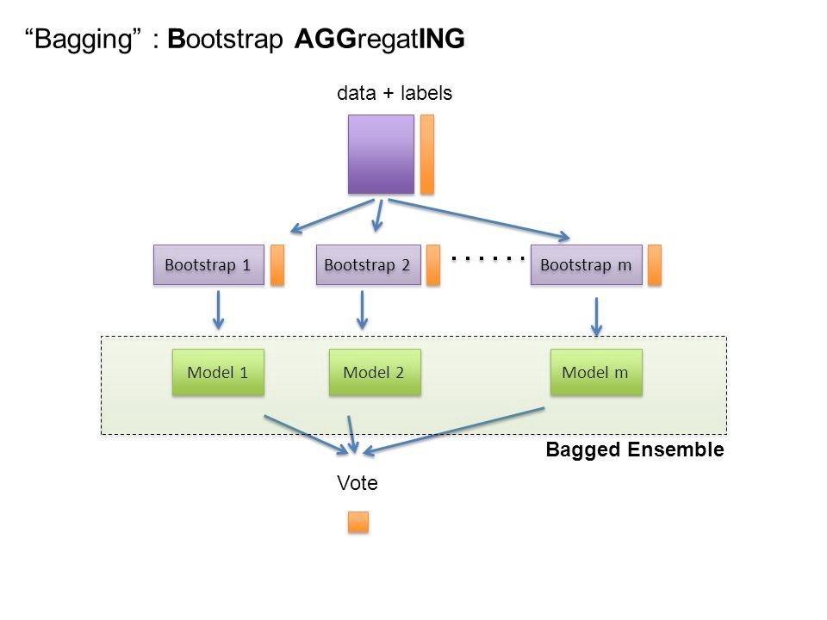
BAGGING
Bagging = bootstrap + aggregating

Slide 39
BAGGING – replacement
In scikit-learn, bagging methods are offered as a unified BaggingClassifier meta-estimator (resp. BaggingRegressor), taking as input a user-specified base estimator along with parameters specifying the strategy to draw random subsets.
Original training dataset: 1, 2, 3, 4, 5, 6, 7, 8, 9, 10
Resampled training set 1: 2, 3, 3, 5, 6, 1, 8, 10, 9, 1 Resampled training set 2: 1, 1, 5, 6, 3, 8, 9, 10, 2, 7 Resampled training set 3: 1, 5, 8, 9, 2, 10, 9, 7, 5, 4
When it’s not used replacement, the method is called pasting

Slide 40
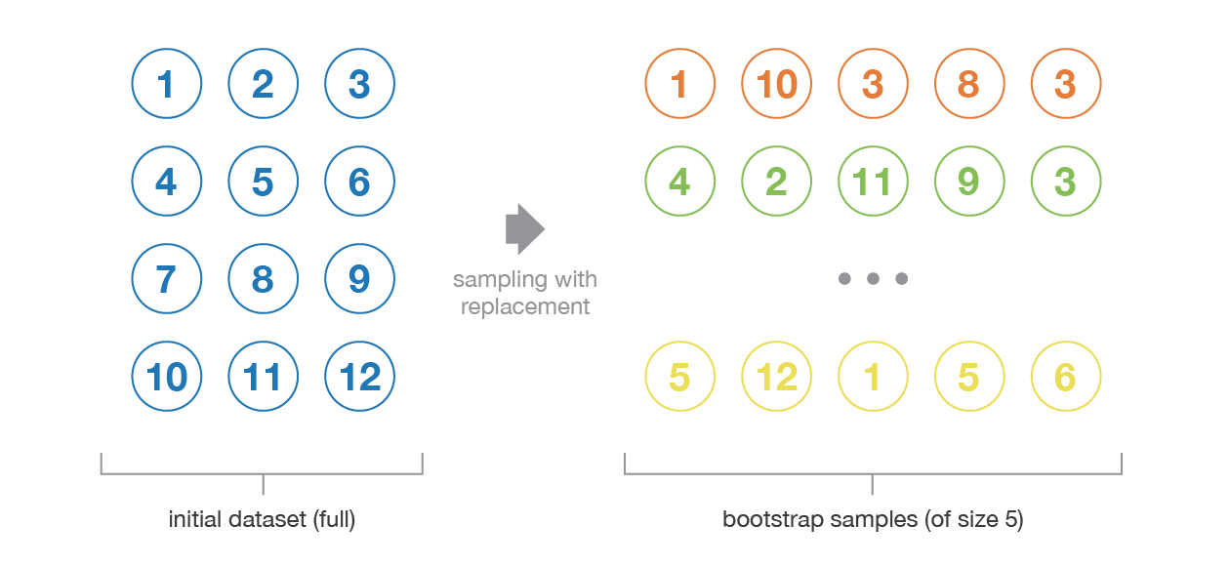
BAGGING – replacement

Slide 41
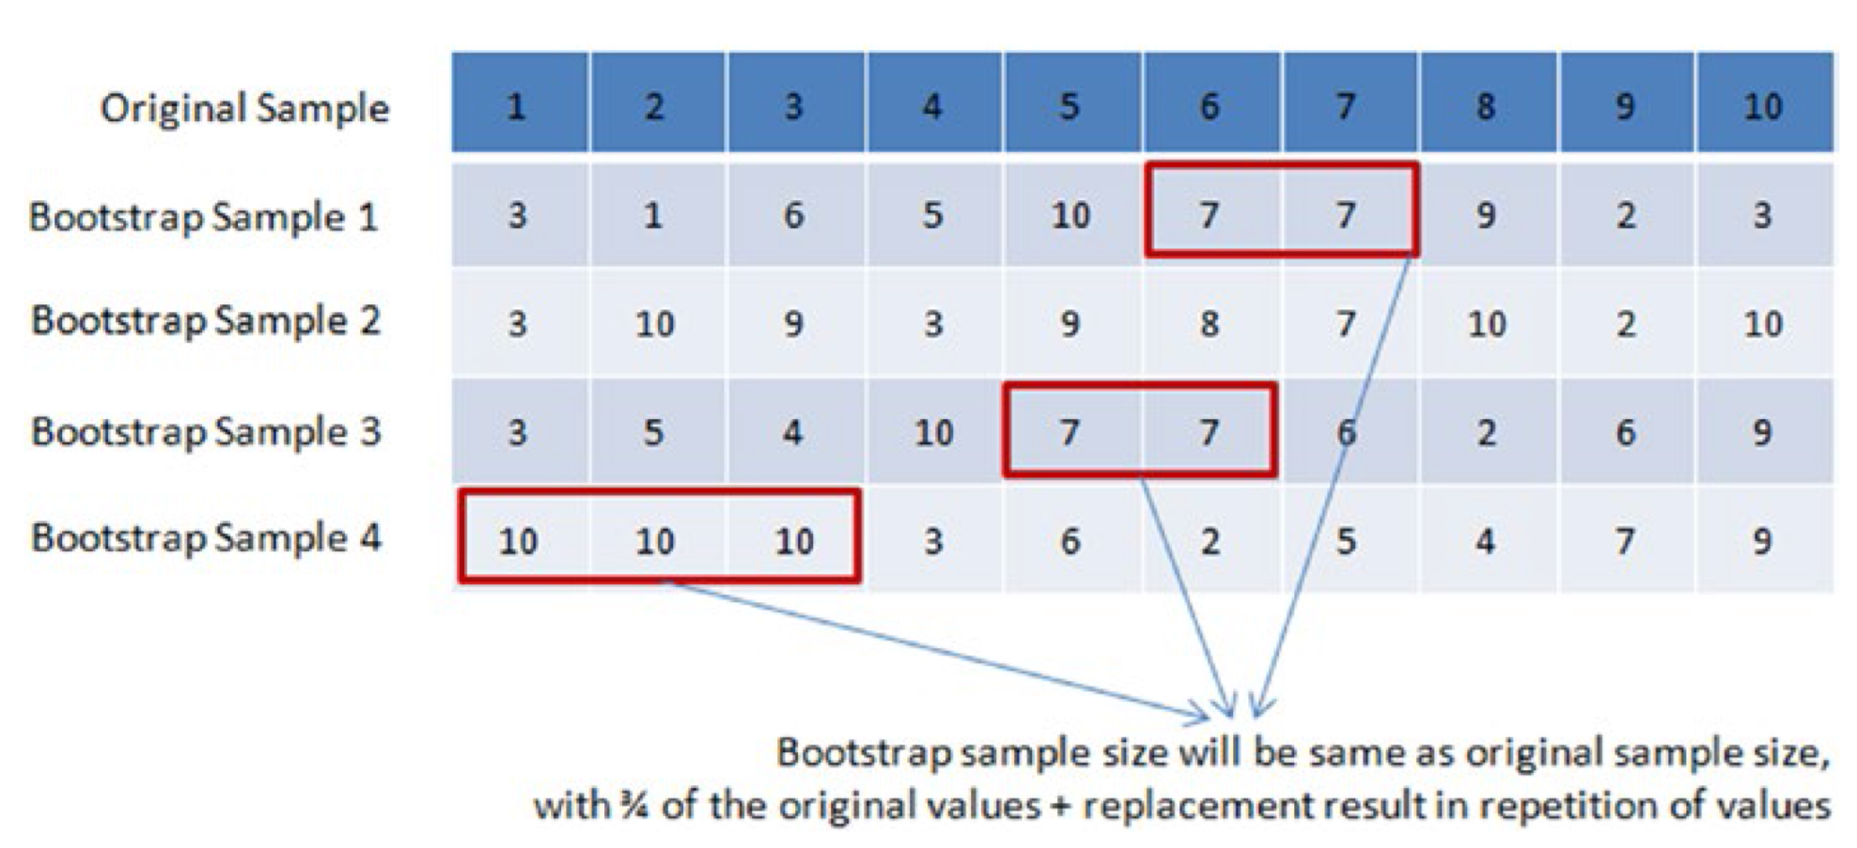
BOOTSTRAP AGGREGATION (Bagging)

Slide 42
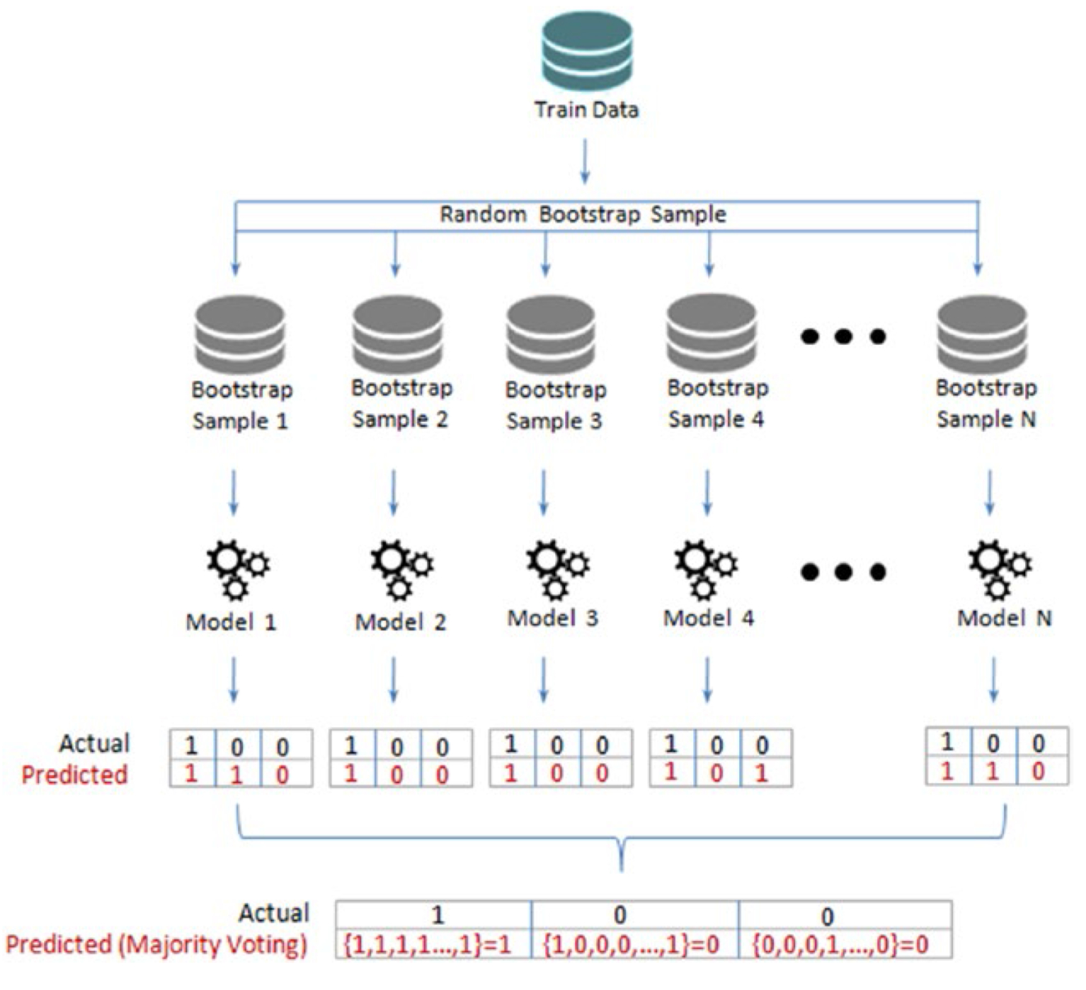
BOOTSTRAP AGGREGATION (Bagging)

Slide 43
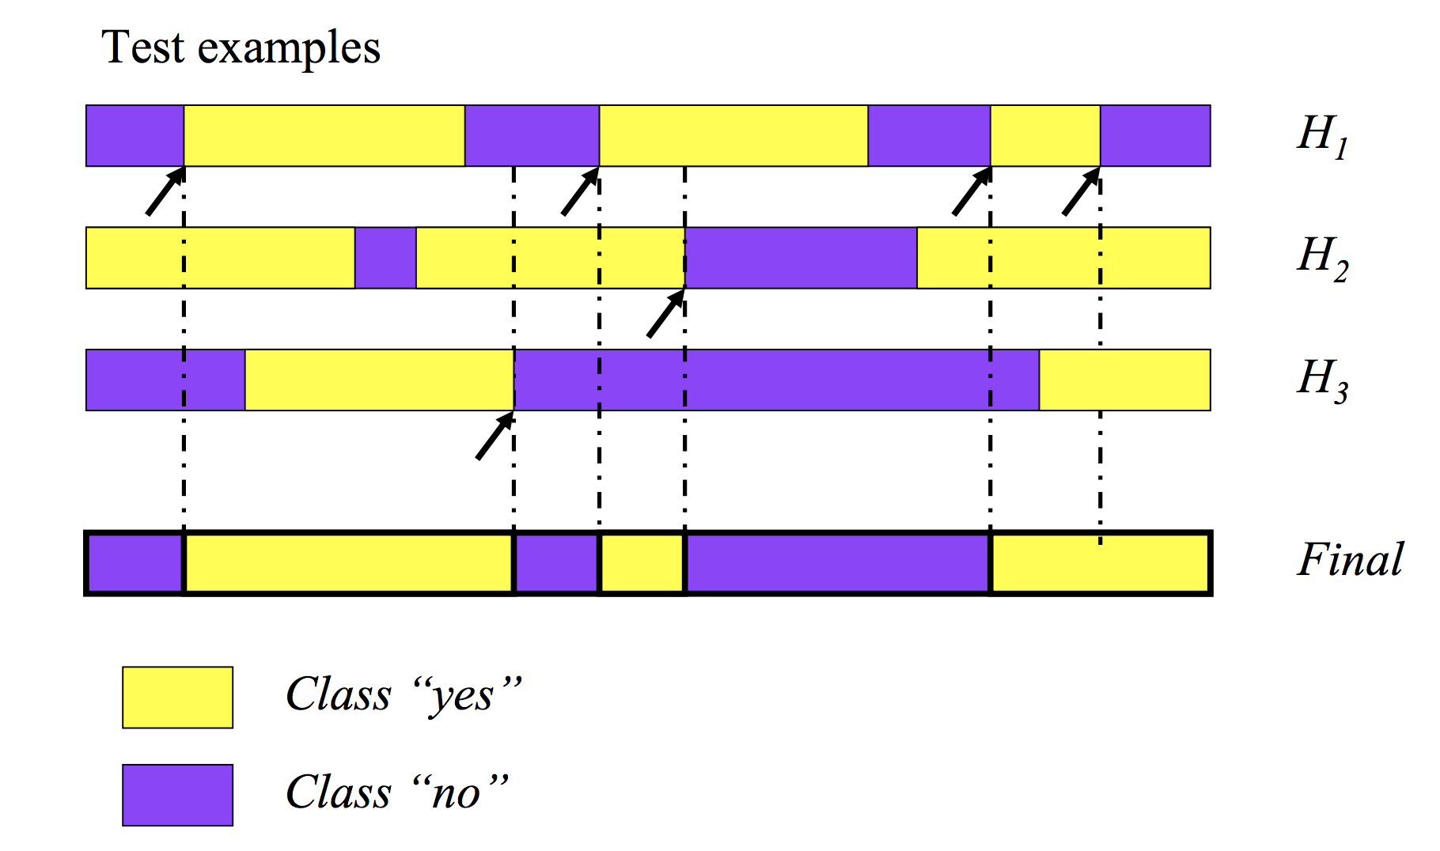
VOTING

Slide 44
BOOTSTRAP AGGREGATION (Bagging)

Slide 45
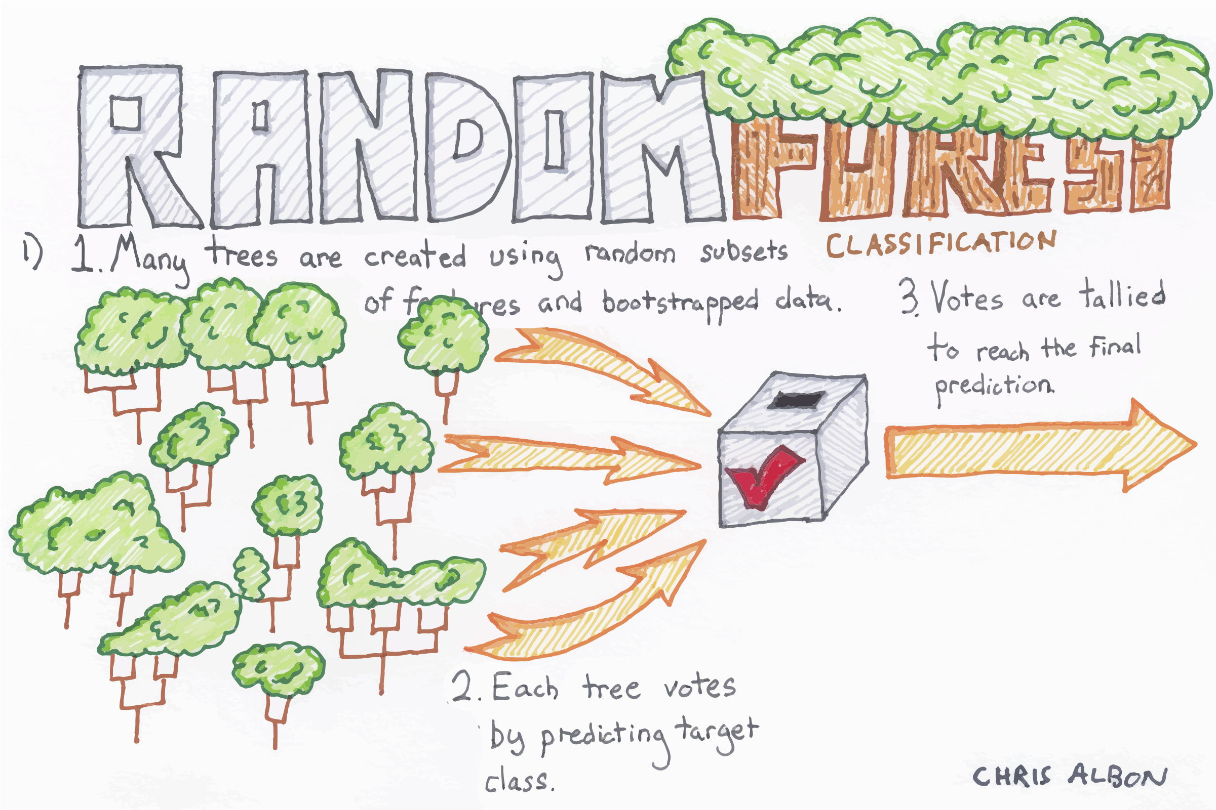
RANDOM FOREST

Slide 46
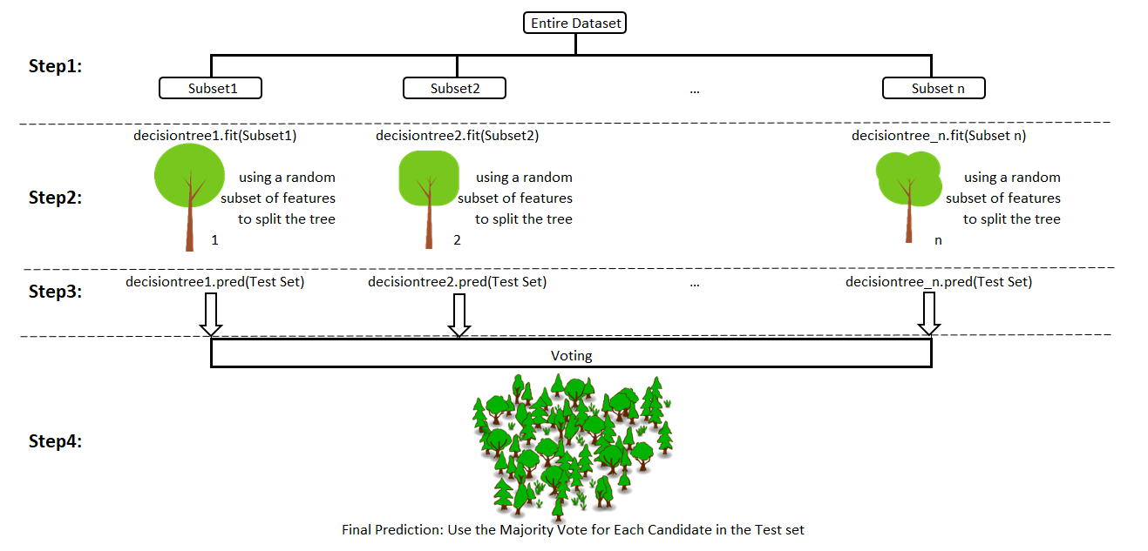
RANDOM FOREST
Random forest is an ensemble model using bagging as the ensemble method and decision tree as the individual model.

Slide 47
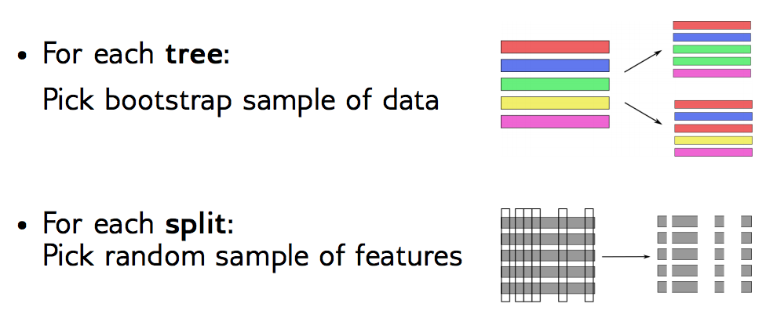
RANDOM FOREST – replacement
Se puede realiza en términos de observaciones y/o en términos de predictores

Slide 48
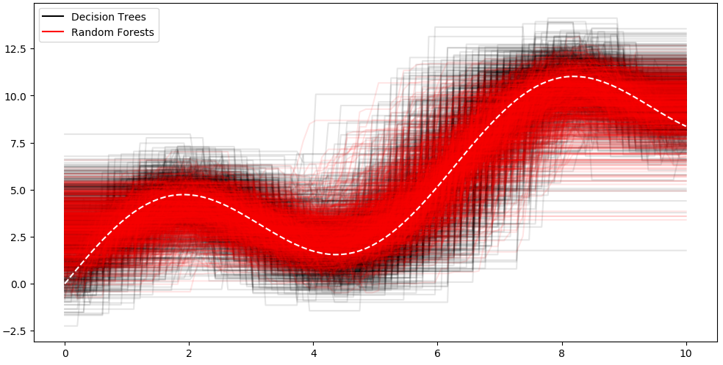
Let us draw 10 samples from our distribution again and fit a Decision Tree and a Random Forest containing 100 Decision Trees. We repeat this procedure 1000 times and get the following picture:
We see that the vertical width of the red tube, formed by the Random Forests is smaller than the Decision Trees’ black tube. So, Random Forests have a lower variance than Decision Trees, as expected. Furthermore, it seems that the averages (the middle) of the two tubes are the same which means that the process of averaging did not change the bias. We still hit the underlying true function 3sin(x)+x quite well.
https://towardsdatascience.com/understanding-the-effect-of-bagging-on-variance-and-bias-visually-6131e6ff1385

Slide 49
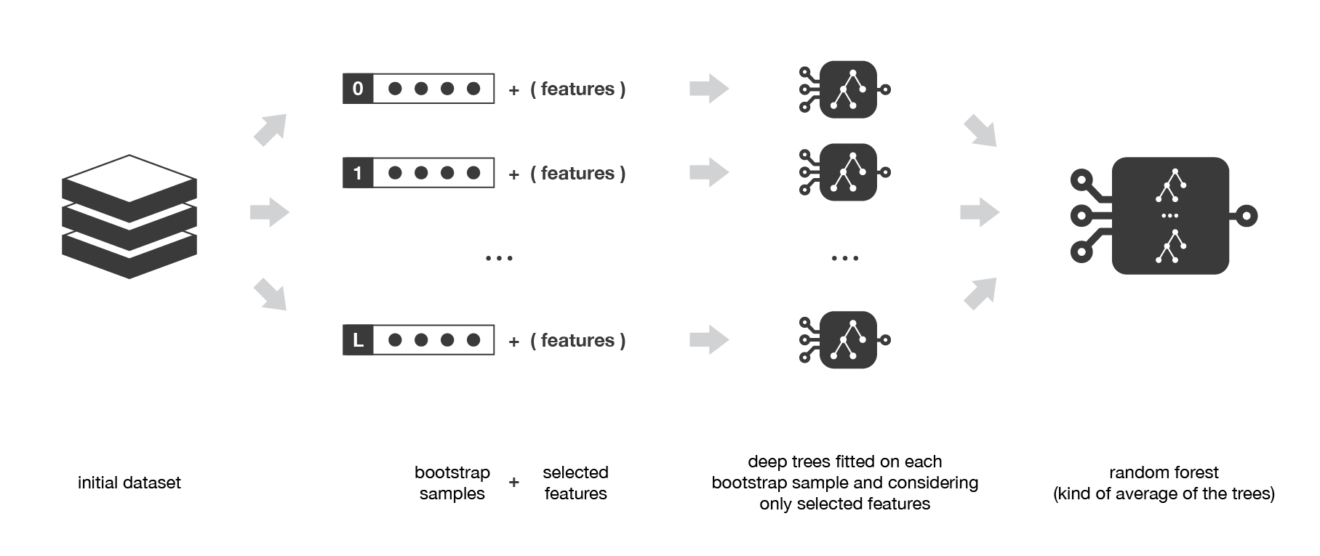
RANDOM FOREST

Slide 50
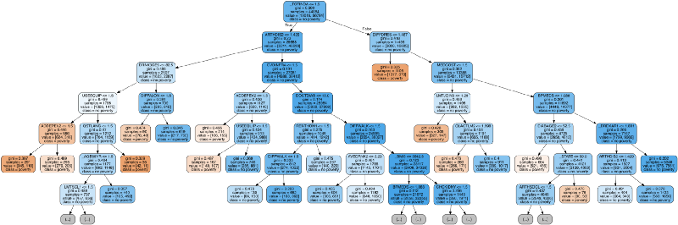
RANDOM FOREST

Slide 51
FEATURE IMPORTANCE

Slide 52
BAGGING
Single model: AUC = 0.791, Accuracy: 0.798
Bagging: AUC = 0.869, Accuracy = 0.816
Pasting: AUC = 0.870, Accuracy = 0.815
Native random forest: AUC = 0.887, Accuracy = 0.838

Slide 53
BOOSTING
Boosting is a method of converting weak learners into strong learners.
base models that are often considered for boosting are models with low variance but high bias
Shallow decision trees (stump)

Slide 54
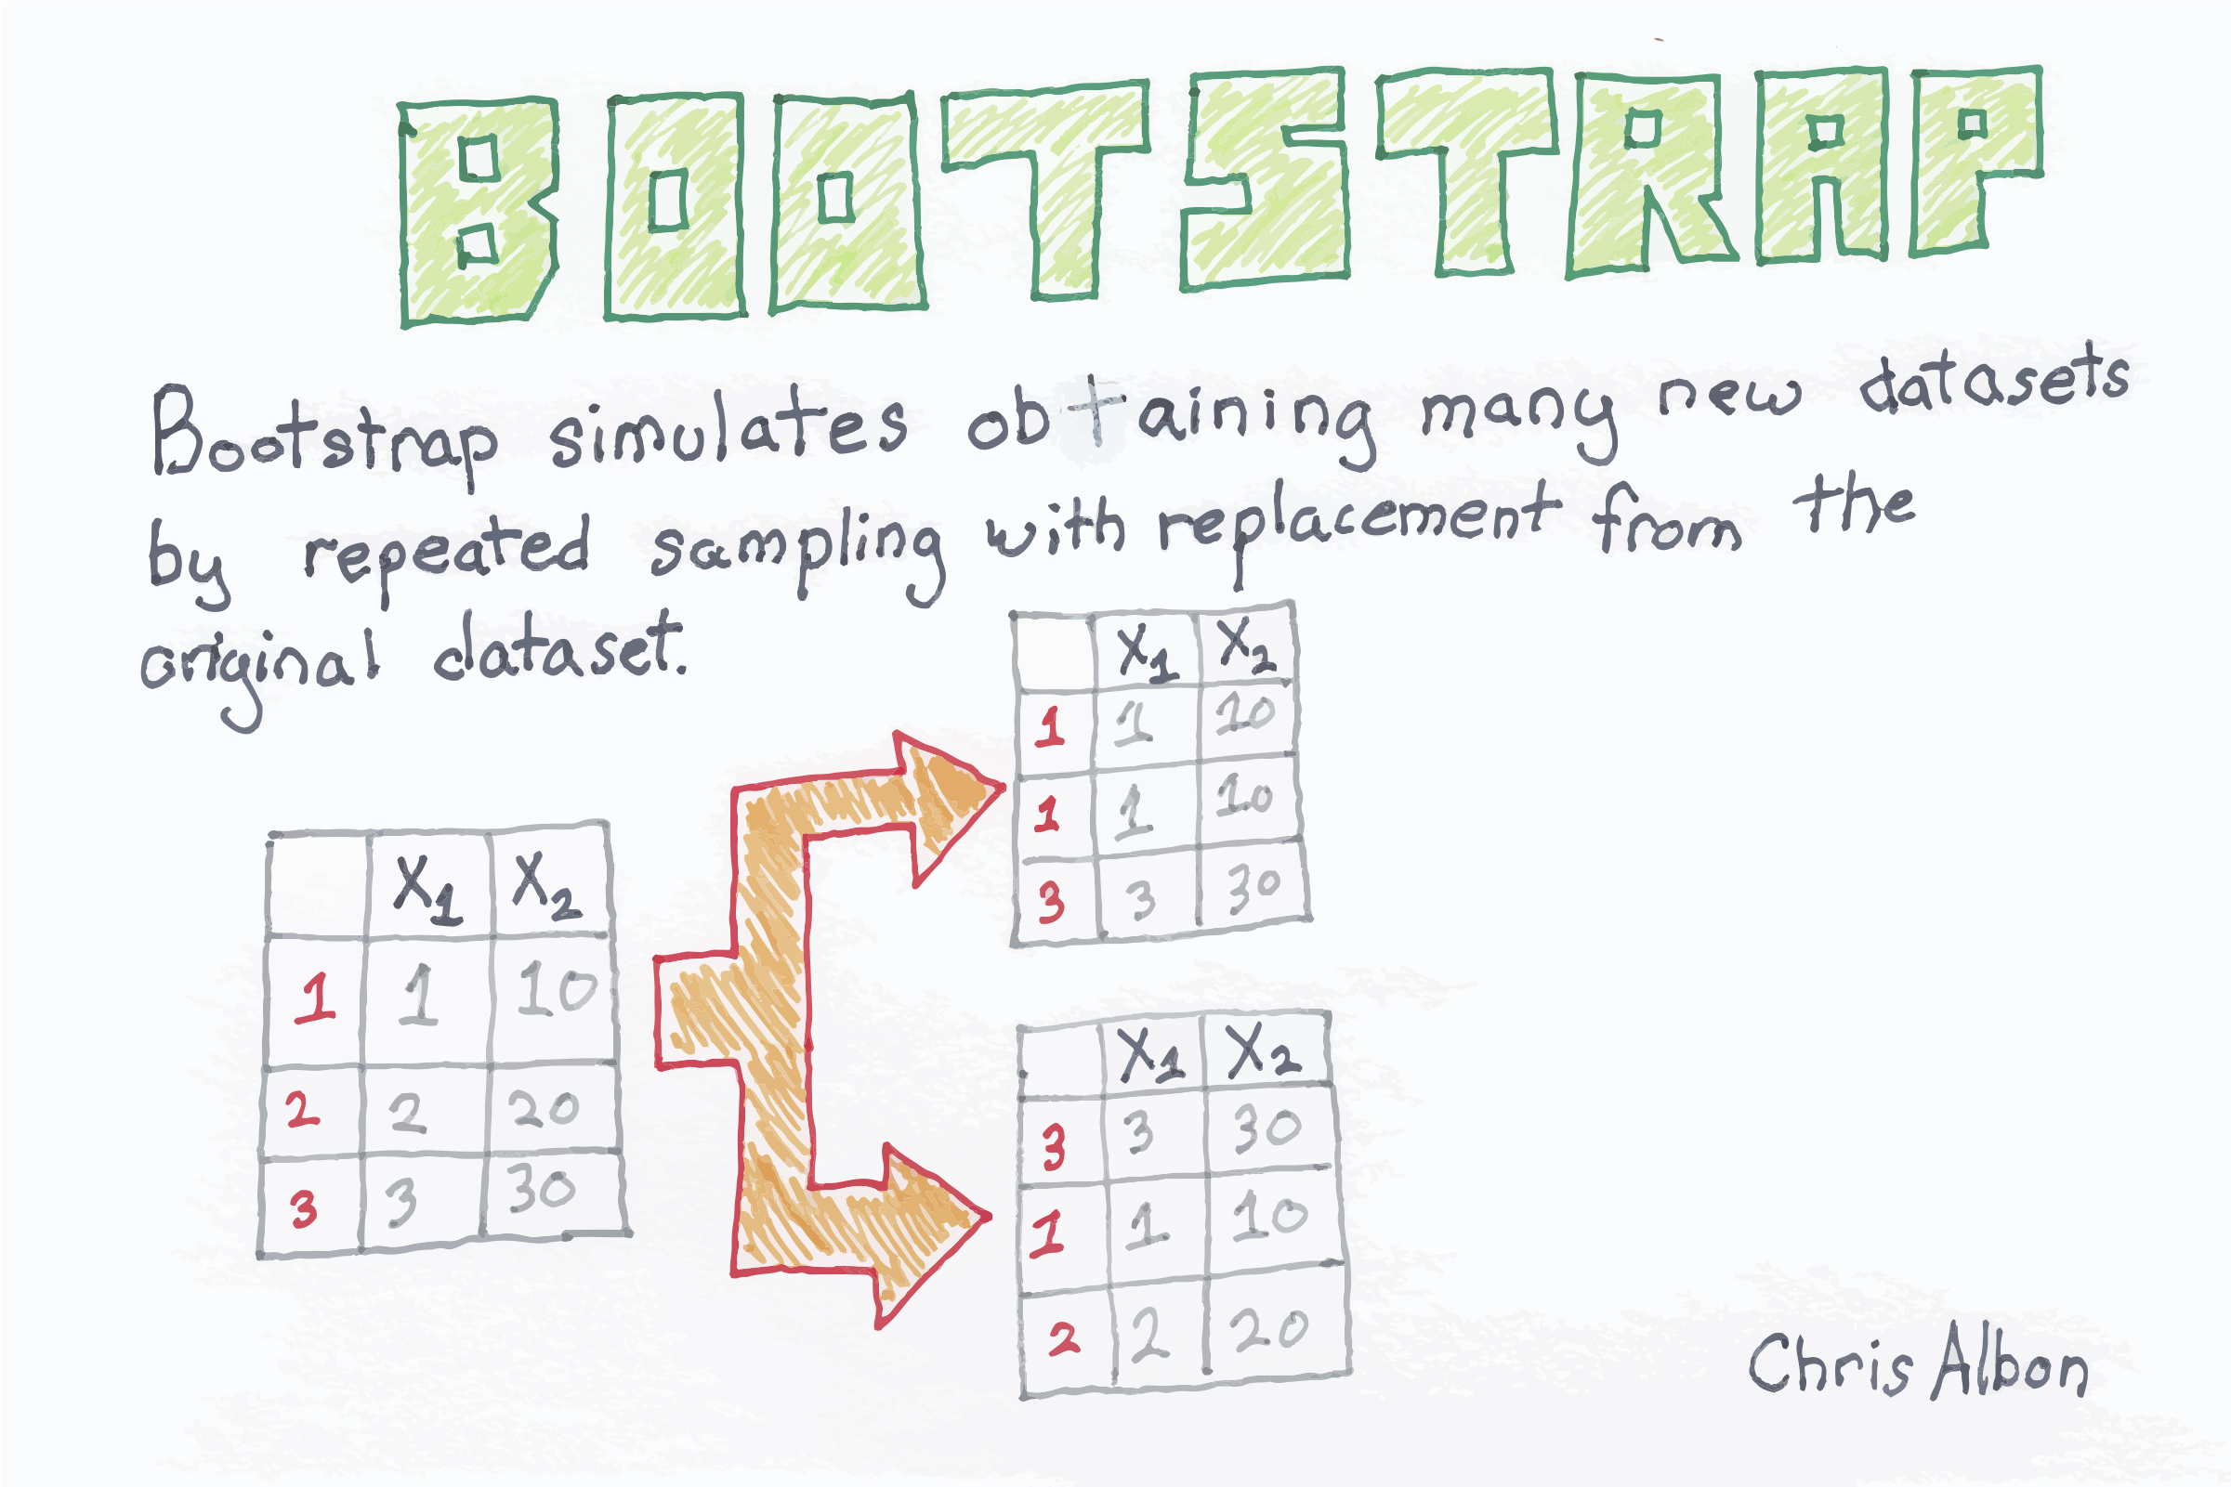
BOOTSTRAP

Slide 55
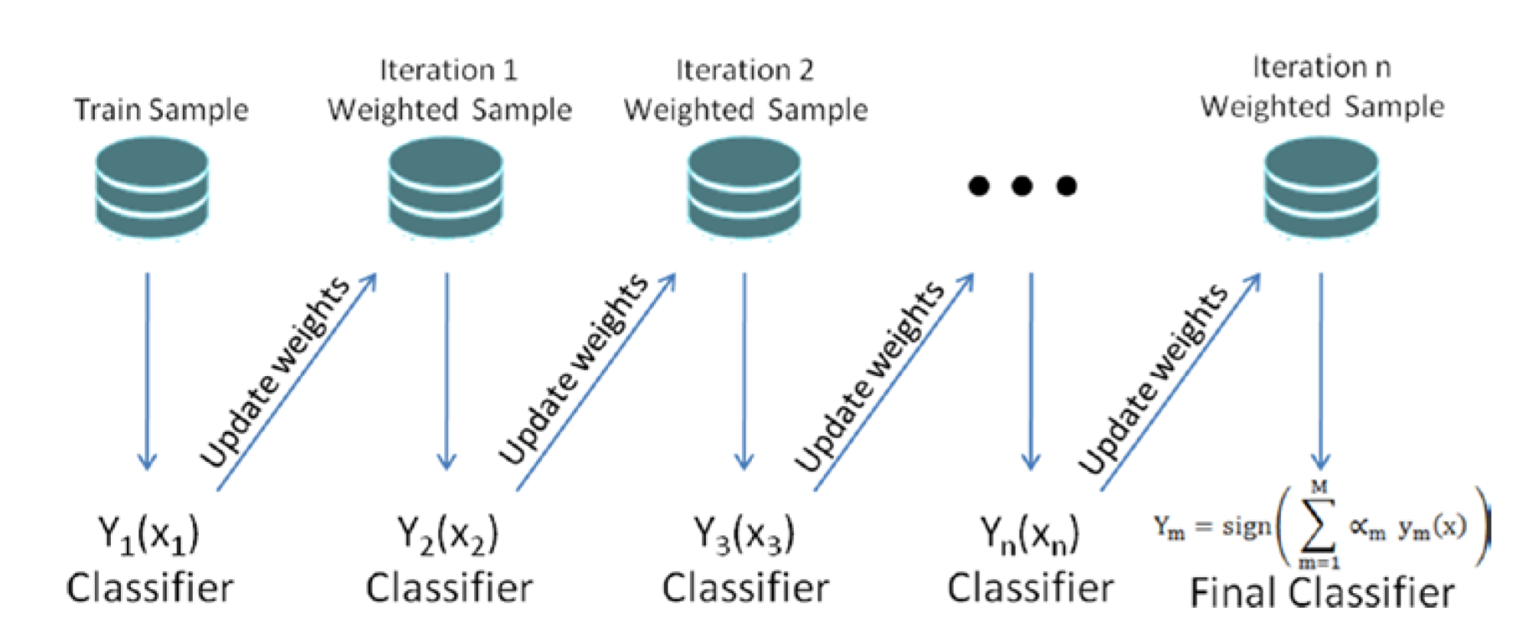
BOOSTING
AdaBoost is a boosting ensemble model and works especially well with the decision tree. Boosting model’s key is learning from the previous mistakes, e.g. misclassification data points.
AdaBoost learns from the mistakes by increasing the weight of misclassified data points.

Slide 56
ADABOOST ALGORITHM (Adaptative Boosting)

Slide 57
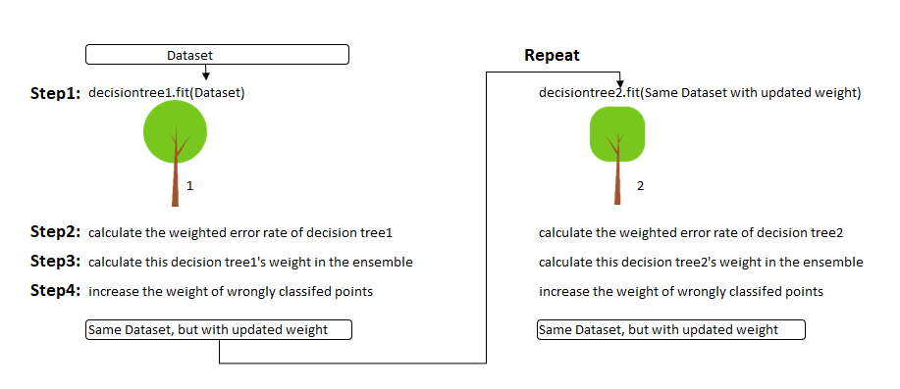
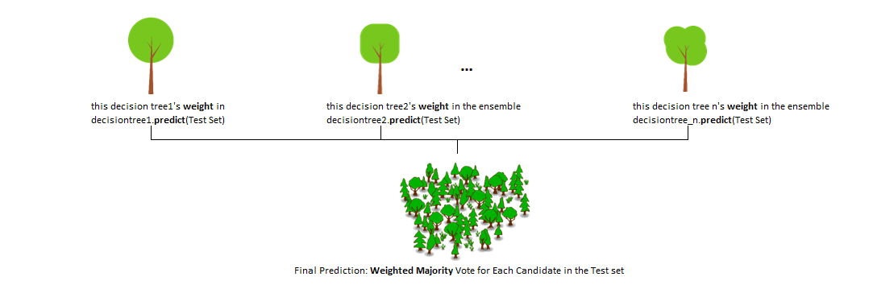
ADABOOST ALGORITHM

Slide 58
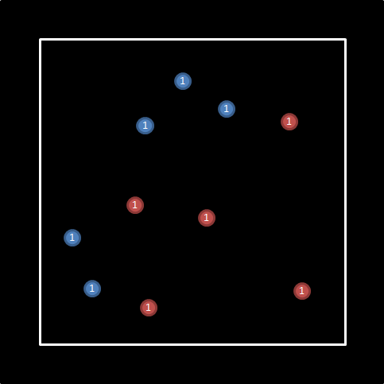
ADABOOST ALGORITHM
Adaboost, developed by Robert Schapire and Yoav Freund in 1996, won the prestigious Gödel award as the first successful boosting algorithm.

Slide 59
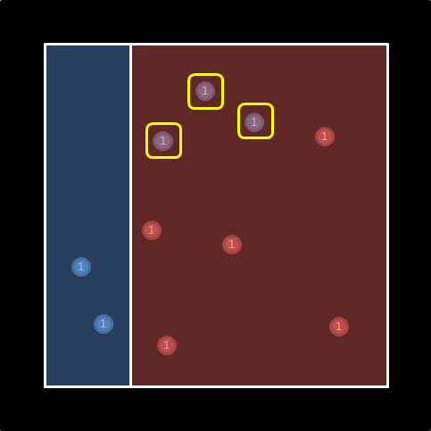
ADABOOST ALGORITHM
As you can see, the 3 points I marked with yellow are on the wrong side. For this reason, we need to increase their weight for the 2nd iteration. But how?.
In the 1st iteration, we have 7 correctly and 3 incorrectly classified points. Let’s assume we want to bring our solution into a 50/50 balance situation. Then we need to multiply the weight of incorrectly classified points with (correct/incorrect) which is (7/3 ≈ 2.33). If we increase the weight of the incorrectly classified 3 points to 2.33, our model will be 50–50%. We keep the results of 1st classification in our minds and go to the 2nd iteration.

Slide 60
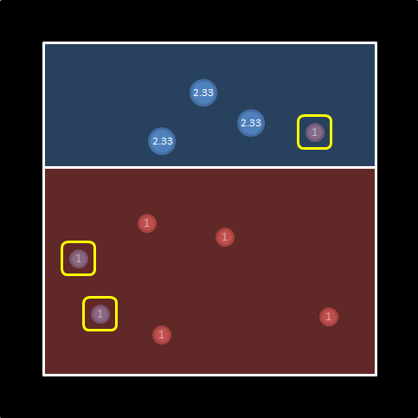
ADABOOST ALGORITHM
In the 2nd iteration, the best solution is as on the left. Correctly classified points have a weight of 11, whereas incorrectly classified points’ weight is 3.
To bring the model back to a 50/50 balance, we need to multiply the incorrectly classified points’ weight by (11/3 ≈ 3.66).
With new weights, we can take our model to the 3rd iteration.

Slide 61
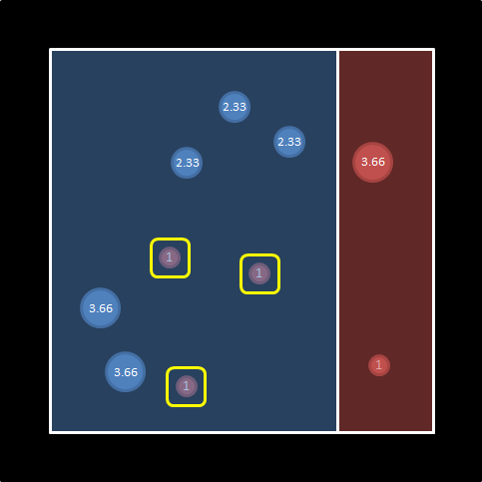
ADABOOST ALGORITHM
The best solution for the 3rd iteration is as on the left. The weight of the correctly classified points is 19, while the weight of the incorrectly classified points is 3 (once again).
We can continue the iterations, but let’s assume that we end it here.
We have now reached the stage of combining the 3 weak learners. But how do we do that?

Slide 62
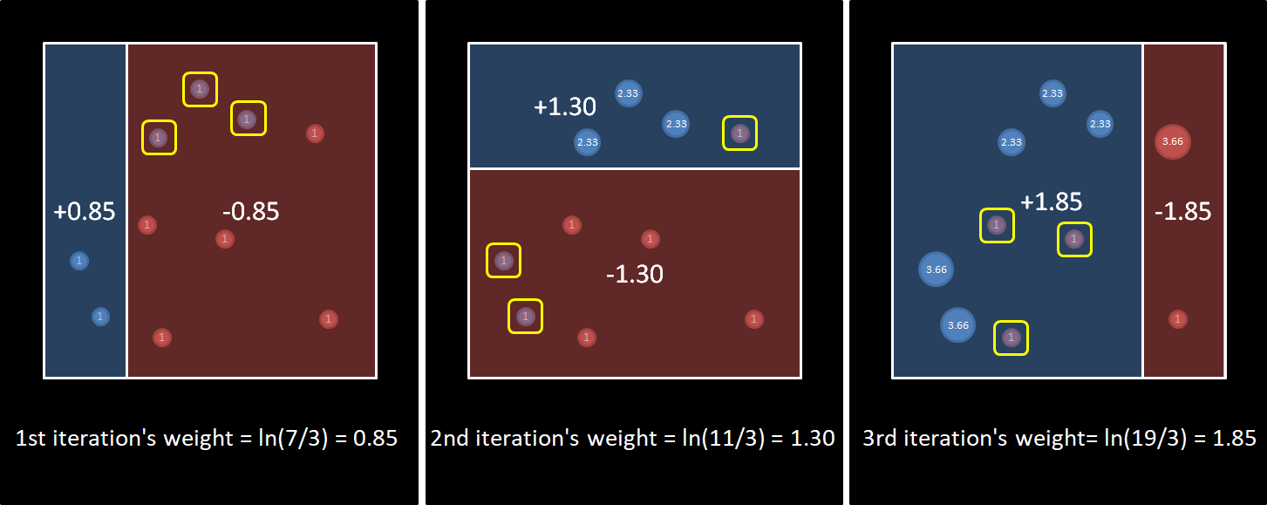
ADABOOST ALGORITHM
ln(correct/incorrect) seems to give us the coefficients we want.

Slide 63
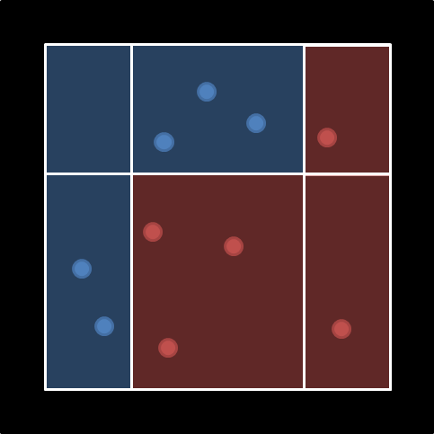
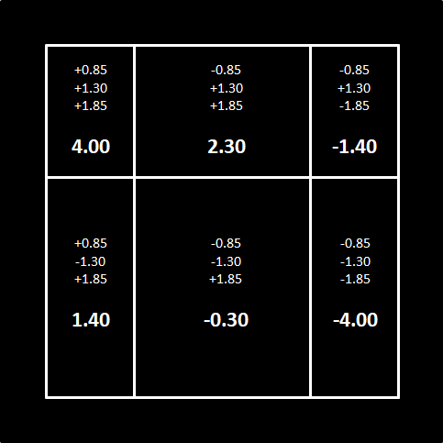
ADABOOST ALGORITHM
If we consider the blue region as positive and the red region as negative; we can combine the result of 3 iterations like the picture on the left.

Slide 64
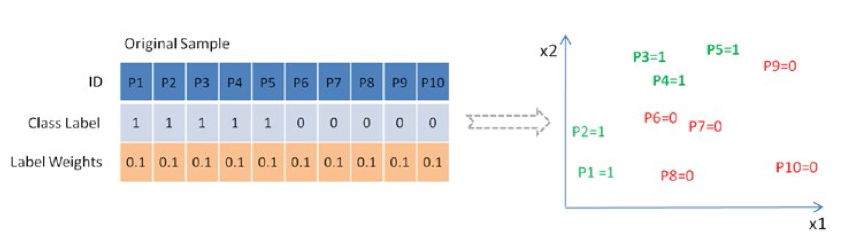

ADABOOST ALGORITHM (Boosting)

Slide 65


ADABOOST ALGORITHM (Boosting)

Slide 66

ADABOOST ALGORITHM (Boosting)

Slide 67


GRADIENT BOOSTING (Gradient descent + Boosting)
Gradient Boosting learns from the mistake — residual error directly, rather than update the weights of data points.

Slide 68

GRADIENT BOOSTING

Slide 69

GRADIENT BOOSTING

Slide 71

PARAMETERS

